Slide 1


An Introspective Study on Cultivation of Coffee and Tea in India
Abhra Roy

Slide 2
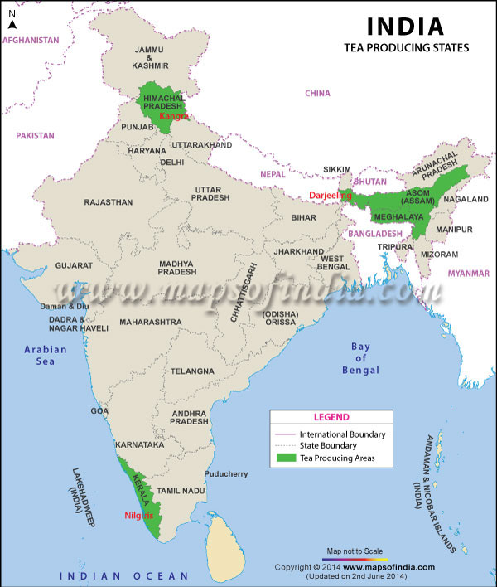
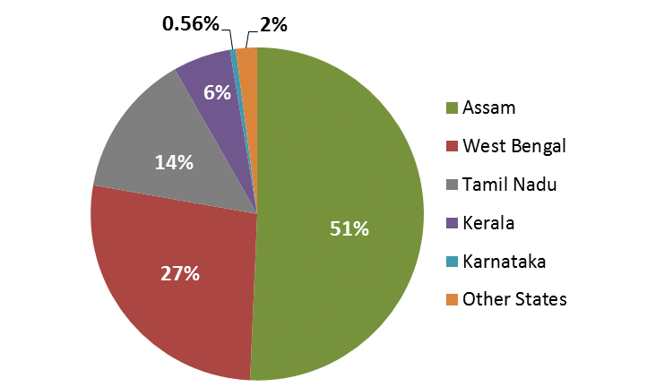
Tea and coffee are one of the oldest organized industries in India, indicating their long-standing presence and importance in the country's economy.
India is a significant player in the tea industry: India is one of the largest tea producers globally, with renowned teas like Assam and Darjeeling originating exclusively in the country. The Indian tea industry has become one of the most technologically equipped and owns many global brands. However, over 70% of India's tea consumption is within the country.
Coffee production in India has experienced significant growth, increasing production volume and the land area devoted to coffee cultivation.

Slide 3
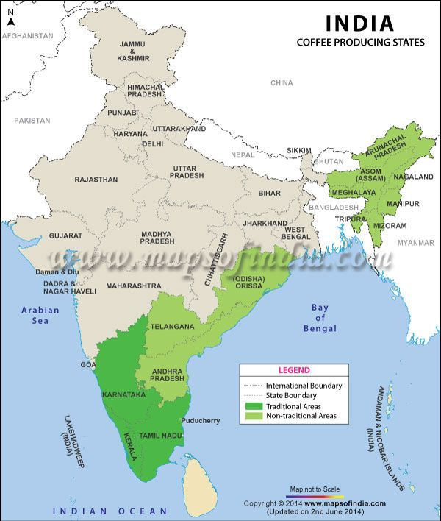
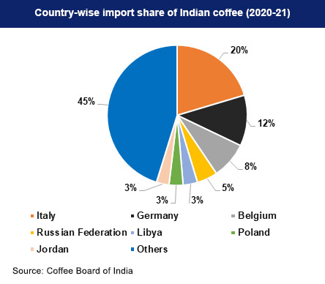
The Coffee Board of India was established in 1942 to regulate coffee export and protect small farmers. Coffee is grown in different regions of India, with Karnataka, Kerala, and Tamil Nadu being the primary traditional coffee-growing areas.
Coffee production in India has experienced significant growth, increasing production volume and the land area devoted to coffee cultivation.
Economic liberalization and favorable labor costs have contributed to the industry's growth. Coffee consumption is higher in south India, and coffee bars like Café Coffee Day have gained popularity in the country.

Slide 4
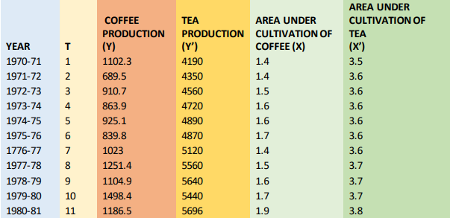
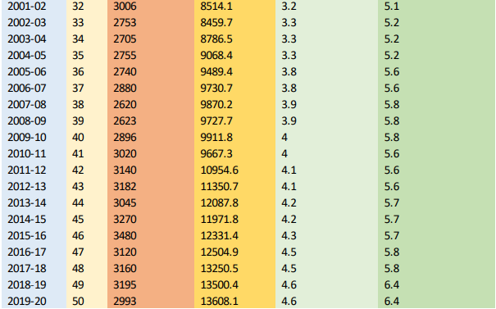
Data Collection
Here, we have collected four datasets, i.e., coffee and tea production and the area under their cultivation(in lack Hector) per year from 1970-71 to 2019-20.
The time series data sets are arranged to treat every financial year as a time point.
Y denotes Coffee Production, Y’ indicates Tea production, and t is the time index.
X denotes the area under cultivation of Coffee, and X’ marks the area under Tea cultivation
Source: Ministry of Agriculture & Farmers Welfare, Government of India, Coffee Board of India, Tea Board of India.
.
.
.

Slide 5
Methodology
Data analysis using statistical methodology: The text mentions using statistical methods to work out several outcomes from the data. This indicates the application of statistical techniques to gain insights and draw conclusions.
Plotting datasets and studying trends: The datasets were plotted in Microsoft Excel to visualize the curves and analyze the variables’ movements. This step helps understand the patterns and changes in the data over time.
Time series models and methods: Different time series models and processes, such as moving average and trend curve fitting, were employed to analyze the data. These techniques help identify patterns, make forecasts, and find the best model that fits the data.
Study variables and predicting equations: After studying the trends and selecting the best model, the study variables and predicting equations were derived. These variables and equations enable forecasting future values for the analyzed variables.

Slide 6
Analysis of regression: The text mentions the correlation and regression analysis between the area under cultivation and the production of tea and coffee, along with other descriptive measures. This indicates the exploration of relationships and dependencies between variables.
Anticipating future needs The outcomes derived from the study, including the analysis of trends, forecasting, and correlation/regression analysis, help predict the future needs of the tea and coffee industries. These insights can guide decision-making and planning for the future.
Importance of the study: The text emphasizes that the research and its outcomes are significant for the tea and coffee industries. It suggests that the findings contribute to understanding the trends, forecasting future needs, and making informed decisions in these industries.

Slide 7
Barplot:
It is commonly used to compare and visualize categorical or discrete data. Each bar in the plot represents a specific category, and the length or height of the bar corresponds to the value or frequency associated with that category.
It is beneficial for displaying data that can be divided into distinct categories or for illustrating the distribution of a variable across different groups.
The x-axis of a bar plot represents the categories or groups being compared, while the y-axis represents the values or frequencies associated with each type. The height or length of the bars reflects the magnitude of the data. The bars can be arranged vertically (column chart) or horizontally (bar chart), depending on the presented data’s preference and nature.

Slide 8
Stationarity:
It refers to a fundamental concept in time series analysis involving the behavior and properties of a sequence of data points observed over time. A stationary time series is one whose statistical properties, such as mean, variance, and autocorrelation, remain constant over time.
Stationarity is an essential assumption for many time series analysis techniques, including forecasting, regression analysis, and modeling. It enables using statistical tools and methods that rely on stationarity properties, such as autoregressive integrated moving average (ARIMA) models.
If a time series is not stationary, it can be made inactive through differencing, where the differences between consecutive observations are taken. This helps remove trends or patterns in the data and makes the series more amenable to analysis.
It implies constant mean, variance, and autocovariance.

Slide 9
ACF:
It measures the correlation between a time series and its lagged values.
It helps determine the relationship between each observation in a time series and its past observations at various time lags.
The ACF plot displays the correlation coefficients on the y-axis and the lagged periods on the x-axis.
By examining the ACF plot, one can identify significant autocorrelation patterns and the number of lags at which the correlations are significant.
PACF:
It measures the correlation between a time series and its lagged values while controlling for the influence of the intermediate legs.
It helps identify the direct relationship between two observations at a particular lag, removing the indirect effects from other lags.
The PACF plot displays the partial correlation coefficients on the y-axis and the lagged periods on the x-axis.
Significant partial autocorrelation coefficients in the PACF plot indicate the number of lags that directly influence the current observation.

Slide 10
Modeling and Forecasting:
It uses statistical and mathematical techniques to analyze past observations and predict future values or patterns.
This process is crucial in various fields, such as economics, finance, marketing, and operations research, where understanding and predicting future trends and behavior is essential for decision-making and planning.
We have used the ‘forecast’ and ‘time-series’ packages in R software for this process.
The modeling and forecasting process typically involves the following steps:
Data collection and Pre-processing
Data Analysis and visualization
Model Selection
Model Devolopment
Forecasting and Model Validation
Communication and Decision making

Slide 11
Regression Analysis:
It aims to establish a functional relationship between a dependent variable and one or more independent variables. It quantifies how changes in the independent variables are associated with changes in the dependent variable.
It is employed for, Prediction, Relationship Analysis, Inference, Hypothesis Testing
It relies on several assumptions, such as linearity, independence, normality of errors, homoscedasticity (constant variance), and absence of multicollinearity.
Various techniques are used to evaluate the performance of regression models, such as R-squared (coefficient of determination), adjusted R-squared, root mean square error (RMSE), and significance tests for coefficients. These metrics assess the model's goodness-of-fit, accuracy, and statistical significance.
Several types of Regression are Linear, Polynomial, Logistic, regression, etc.
For this discussion, Linear and Polynomial Regression is used to model the area of cultivation against the amount of tea or coffee produced.

Slide 12
Prediction:
For the best-fitted model on the data we would like to predict the future of tea and coffee cultivation in India.
The model of area under production on production and demand of the drink is forecasted for next 10 years and hence we tried to conclude according to the urge in demand of these drinks’ the prospect in Economic point of view.
For the growing tea and coffee production required area for its betterment is also predicted in the following discussion.

Slide 13
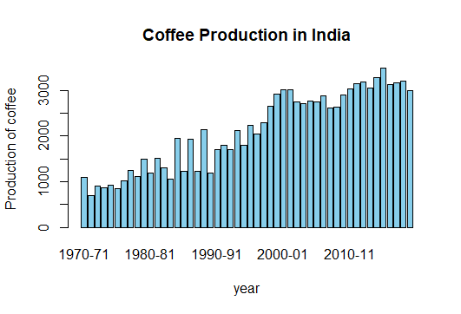
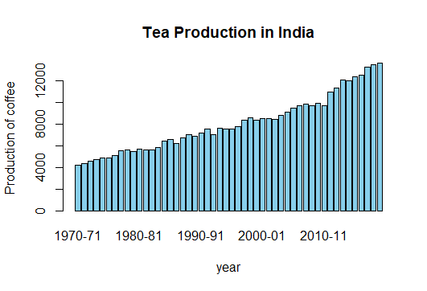
Results
Barplots

Slide 14
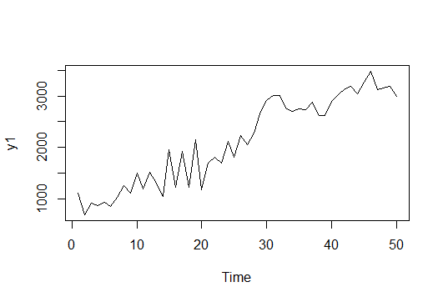
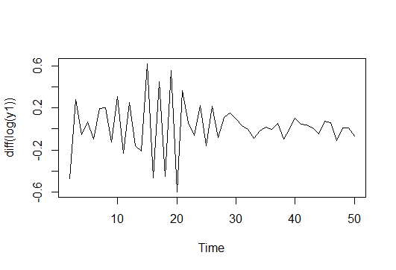
Augmented Dickey-Fuller Test:
The Dickey-Fuller test is a statistical test used to determine whether a time series is stationary or non-stationary.
Δy(t) = β₀ + β₁t + β₂Δy(t-1) + β₃Δy(t-2) + ... + βₚΔy(t-p) + ε(t)
Where,
Δy(t) represents the differenced time series (first difference of the original series)
t is a time trend variable
Δy(t-i) illustrates lagged differences of the time series up to order p
ε(t) is the error term
Augmented Dickey-Fuller Test
data: diff(y1)
Dickey-Fuller = -4.1252, Lag order = 3, p-value = 0.01182
alternative hypothesis: stationary
Actual Data for Coffee Production
Coffee Data after Transformation

Slide 15
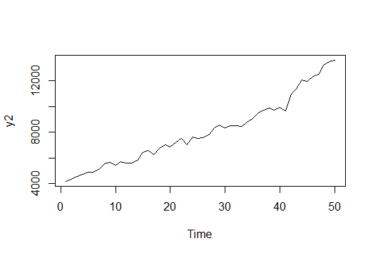
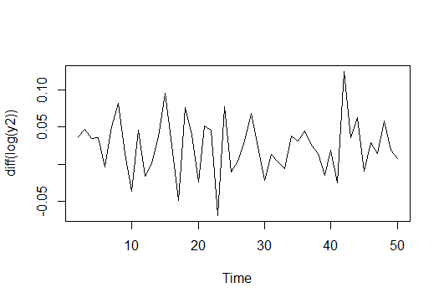
Actual Data for Tea Production
Null Hypothesis: Tea Data is not Stationary
Alternate Hypothesis: Tea Data is Stationary
Augmented Dickey-Fuller Test
data: diff(log(y2))
Dickey-Fuller = -4.1721, Lag order = 3, p-value = 0.01
alternative hypothesis: stationary
Tea Data after Transformation

Slide 16
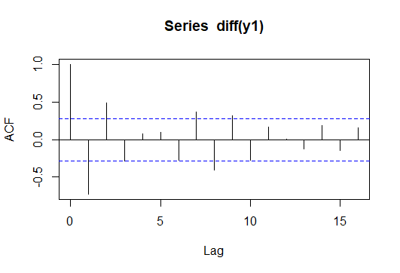
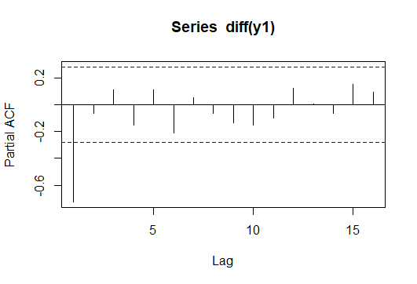
PACF for Coffee Production data
ACF for Coffee Production data

Slide 17
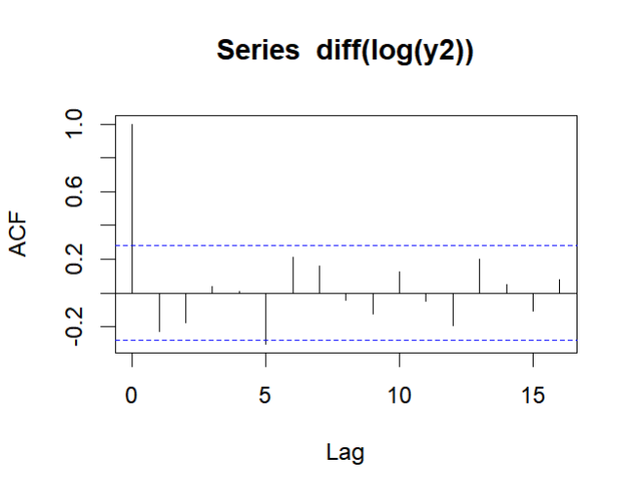
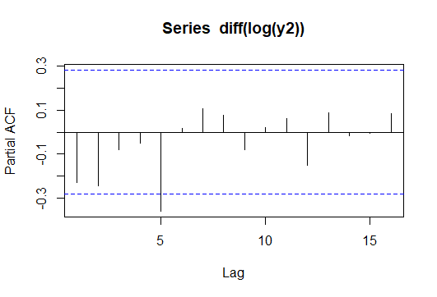
PACF for Tea Production data
ACF for Tea Production data

Slide 18
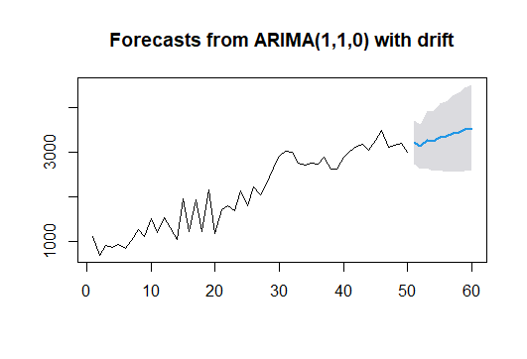
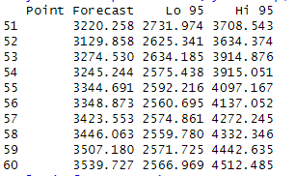
Modelling and Forecasting
Coffee Production Data:
Using ‘auto.arima’ function, we can say the data can be modelled as ARIMA(1,1,0) series.
ARIMA(1,1,0) with drift
Coefficients:
ar1 drift
-0.740 44.6976
s.e. 0.095 20.2135
sigma^2 = 62065: log likelihood = -339.28
AIC=684.57 AICc=685.1 BIC=690.24

Slide 19
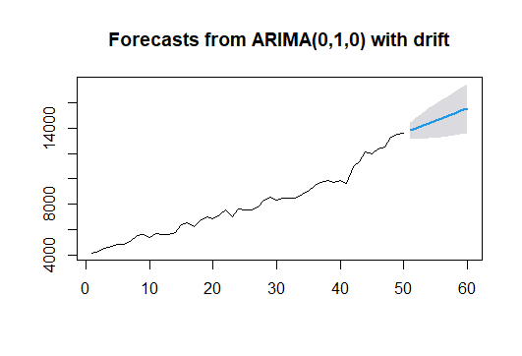
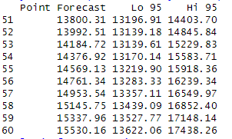
Tea Production Data:
Using ‘auto.arima’ function clearly the data follows a ARIMA(0,1,0) series.
ARIMA(0,1,0) with drift
Coefficients:
drift
192.2061
s.e. 43.5288
sigma^2 = 94778: log likelihood = -349.78
AIC=703.55 AICc=703.81 BIC=707.33

Slide 20
Linear Regrssion
Regression of Cultivation area on Coffee Production
lm(formula = Area.under.caltivation.of.coffee ~ Coffee.Production,
data = data)
Residuals:
Min 1Q Median 3Q Max
-0.72582 -0.24192 0.00772 0.30078 0.79583
Coefficients:
Estimate Std. Error t value Pr(>|t|)
(Intercept) 3.940e-01 1.462e-01 2.694 0.00969 **
Coffee.Production 1.139e-03 6.423e-05 17.739 < 2e-16 ***
Residual standard error: 0.3826 on 48 degrees of freedom
Multiple R-squared: 0.8676, Adjusted R-squared: 0.8649
F-statistic: 314.7 on 1 and 48 DF, p-value: < 2.2e-16

Slide 21
Regression of Cultivation area on Tea Production
lm(formula = Area.under.caltivation.of.tea ~ Tea.Production,
data = data)
Residuals:
Min 1Q Median 3Q Max
-0.52432 -0.17009 -0.06963 0.13814 0.61342
Coefficients:
Estimate Std. Error t value Pr(>|t|)
(Intercept) 2.045e+00 1.248e-01 16.38 <2e-16 ***
Tea.Production 3.230e-04 1.476e-05 21.88 <2e-16 ***
---
Signif. codes: 0 ‘***’ 0.001 ‘**’ 0.01 ‘*’ 0.05 ‘.’ 0.1 ‘ ’ 1
Residual standard error: 0.2696 on 48 degrees of freedom
Multiple R-squared: 0.9089, Adjusted R-squared: 0.907
F-statistic: 478.8 on 1 and 48 DF, p-value: < 2.2e-16

Slide 22
Polynomial Regrssion
Regression of Cultivation area on Coffee Production
lm(formula = Area.under.caltivation.of.coffee ~ poly(Coffee.Production,
2, raw = TRUE), data = data)
Residuals:
Min 1Q Median 3Q Max
-0.78509 -0.24667 -0.02556 0.26365 0.74801
Coefficients:
Estimate Std. Error t value Pr(>|t|)
(Intercept) 1.537e+00 3.649e-01 4.211 0.000114 ***
poly(Coffee.Production, 2, raw = TRUE)1 -1.890e-04 3.995e-04 -0.473 0.638336
poly(Coffee.Production, 2, raw = TRUE)2 3.216e-07 9.568e-08 3.361 0.001549 **
---
Signif. codes: 0 ‘***’ 0.001 ‘**’ 0.01 ‘*’ 0.05 ‘.’ 0.1 ‘ ’ 1
Residual standard error: 0.3472 on 47 degrees of freedom
Multiple R-squared: 0.8933, Adjusted R-squared: 0.8888
F-statistic: 196.7 on 2 and 47 DF, p-value: < 2.2e-16

Slide 23
Polynomial Regrssion
Regression of Cultivation area on Tea Production
lm(formula = Area.under.cultivation.of.tea ~ poly(Tea.Production,
2, raw = TRUE), data = data)
Residuals:
Min 1Q Median 3Q Max
-0.52157 -0.19300 -0.02852 0.16294 0.54481
Coefficients:
Estimate Std. Error t value Pr(>|t|)
(Intercept) 1.274e+00 3.861e-01 3.300 0.00185 **
poly(Tea.Production, 2, raw = TRUE)1 5.175e-04 9.370e-05 5.523 1.41e-06 ***
poly(Tea.Production, 2, raw = TRUE)2 -1.113e-08 5.299e-09 -2.101 0.04102 *
---
Signif. codes: 0 ‘***’ 0.001 ‘**’ 0.01 ‘*’ 0.05 ‘.’ 0.1 ‘ ’ 1
Residual standard error: 0.2605 on 47 degrees of freedom
Multiple R-squared: 0.9167, Adjusted R-squared: 0.9132
F-statistic: 258.7 on 2 and 47 DF, p-value: < 2.2e-16

Slide 24
Predictive Analysis
We wanted to predict according to the urge and production of Coffee and Tea how much are for their cultivation is necessary.
We have used ‘predict’ function in R software to forecast the area requirements according to the best fitted model
Coffee cultivation area forecast for next 10 years:
Year 2021 2022 2023 2024 2025 2026 2027 2028 2029 2030
Land 4.263166 4.095625 4.366275 4.310400 4.502376 4.510591 4.659100 4.704620 4.829744 4.897358
Tea cultivation area forecast for next 10 years:
Year 2021 2022 2023 2024 2025 2026 2027 2028 2029 2030
Land 6.296160 6.336161 6.375342 6.413698 6.451233 6.487945 6.523833 6.558901 6.593146 6.626566

Slide 25
Conclusion
In conclusion, the time series forecasting for tea and coffee production in India over the
next 10 years indicates potential growth in both sectors. For tea production, the forecasted
values show a steady increase, with a point forecast ranging from 13,800.31 lacs kg to
14,403.70 lacs kg in the first year, and reaching 15,530.16 lacs kg in the tenth year.
The lower and upper bounds provide a range of possible values within which the actual
production may fall.
Similarly, the forecasted values for coffee production exhibit a positive trend. The point
forecast ranges from 3,220.258 lacs kg to 3,708.543 lacs kg in the first year and
increases to 3,539.727 lacs kg in the tenth year. The lower and upper bounds provide
the range of uncertainty associated with these predictions.
Furthermore, a polynomial regression model was found to be the best fit for both tea and
coffee production data with area under cultivation. The predicted values based on this model show an upward trend, indicating a potential increase in production over time. For coffee,
the predicted values for the next 10 years range from 4.263166 to 4.897358, while for tea, they range from 6.296160 to 6.626566.
Overall, these forecasts suggest a positive outlook for tea and coffee production in India,
with expected growth in the coming years. However, it is important to note that these
forecasts are based on historical data and assumptions, and external factors such as weather
conditions and market dynamics can influence the actual production levels. Regular monitoring
and adjustment of the forecasts are necessary to ensure accurate planning and decision-making
in the tea and coffee sectors.

Slide 26
REFERENCES
Fundamental of statistics vol – 1 & 2 (A.M Gun, M.K Gupta, B.D Dasgupta)
2. Fundamental of applied statistics (S.C Gupta, V.K Kapoor)
3. Fundamental of mathematical statistics (S.C Gupta, V.K Kapoor)
4. Ministry of Agriculture & Farmers Welfare, Government of India
5. Coffee Board of India, Tea Board of India
6. Wikipedia and Internet

Slide 27
Thank YOU

